Slide 1
Do you know which products of your company are faring the best and the worst? It would help you to better forecast stocks and improve the sales performance.

Slide 2
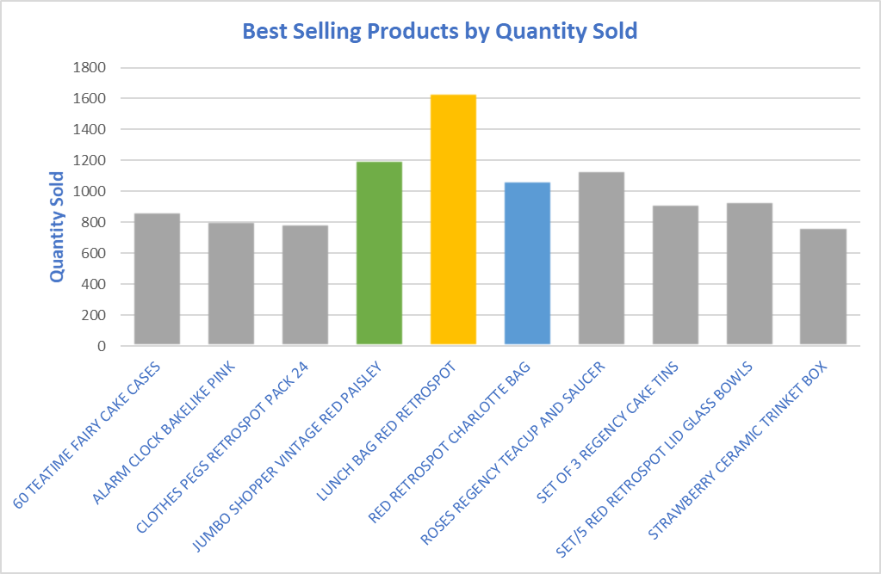
What product or products sold the best?
Listing the top 10 bestselling products by Quantity sold would give you a high level overview about best performing products
‘Lunch bag red retro sport’ was the best performer
‘Jumbo shopper vintage red paisley’ and ‘Red retro sport charlotte’ came after.

Slide 3
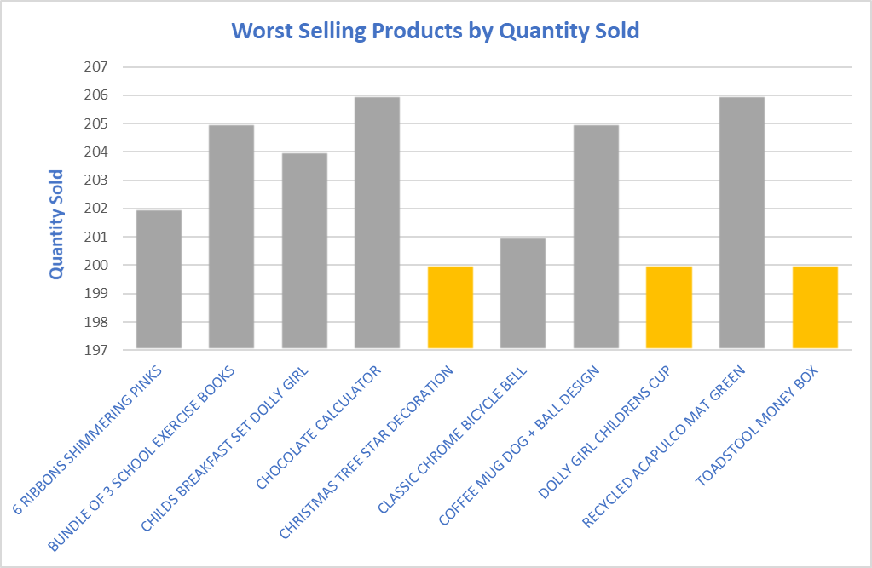
What product or products might they want to discontinue selling?
On the other side, listing the bottom 10 bottom selling products by Quantity sold would give you a high level overview about worst performing products
we have three products rank last, ‘Christmas tree star’, ‘Dolly girl’ and ‘Toadstool money box’

Slide 4
Further Analysis
A deeper analysis would be needed to investigate the best and worst selling products,
e.g.
Sales volume compared to competition
Price-Sales Regression Analysis

Slide 5
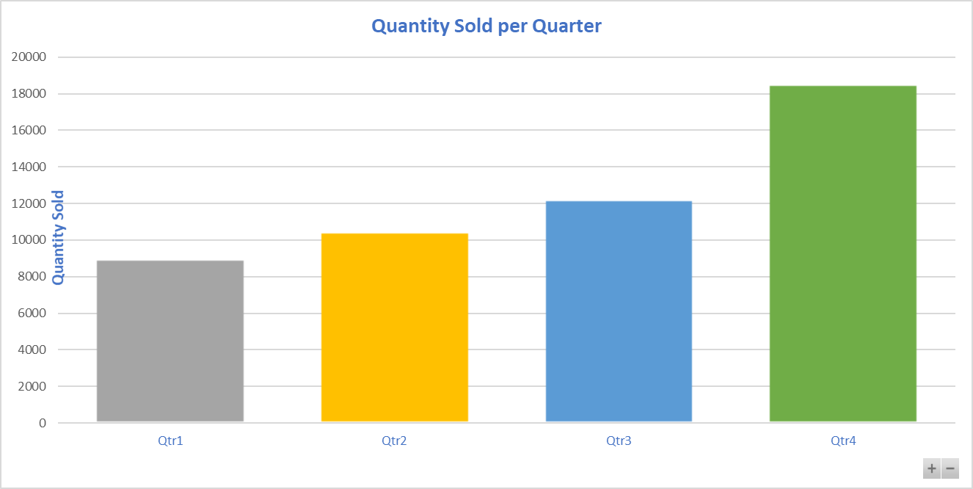
Was there any data that suggested seasonality?
Seasonal forecasts help you get ready for events and to refill your stock.
Looking for quarterly sold quantities, we see Q4 is much better performing compared to other quarters, while Q1 is the least performing one.

Slide 6
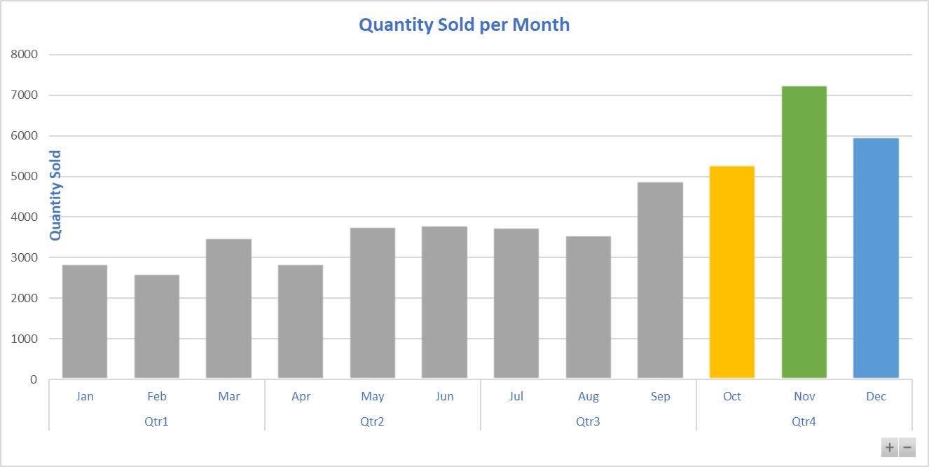
Was there any data that suggested seasonality?
Deeper inside, the monthly sold quantities showed the November and December and October are the best performing months

Slide 7
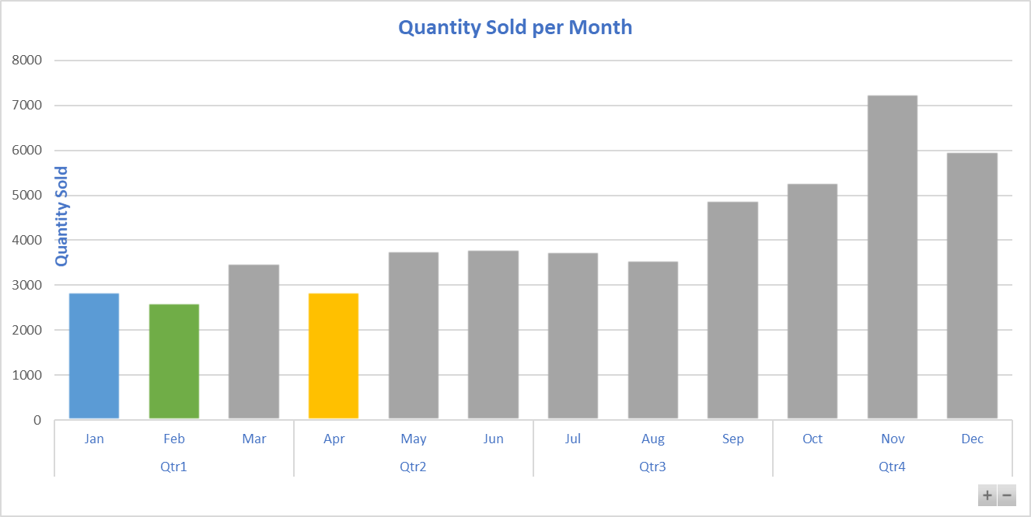
Was there any data that suggested seasonality?
While February, January and April are the least performing month

Slide 8
Further Analysis
A deeper analysis would be needed to investigate seasonality and impact on sales, e.g.
Time Seasonality per product
Correlation between different products during different seasons

